Slide 1
COMP90054
AI Planning for Autonomy
Project2 PACMAN
Zongru Li 947539
Zheng Shi 979554
Zihan Deng 983358

Slide 2
INDEX
Design Decision
Approaches Taken
Challenges Experienced
Possible Improvements
Experiment Section

Slide 3
Design Decision
Problems
Approaches
compute the steps fast at the start of this game
maps are changed frequently
difficulty of implementation
method should collect as much information as possible
A-Star
Q-Learning

Slide 4
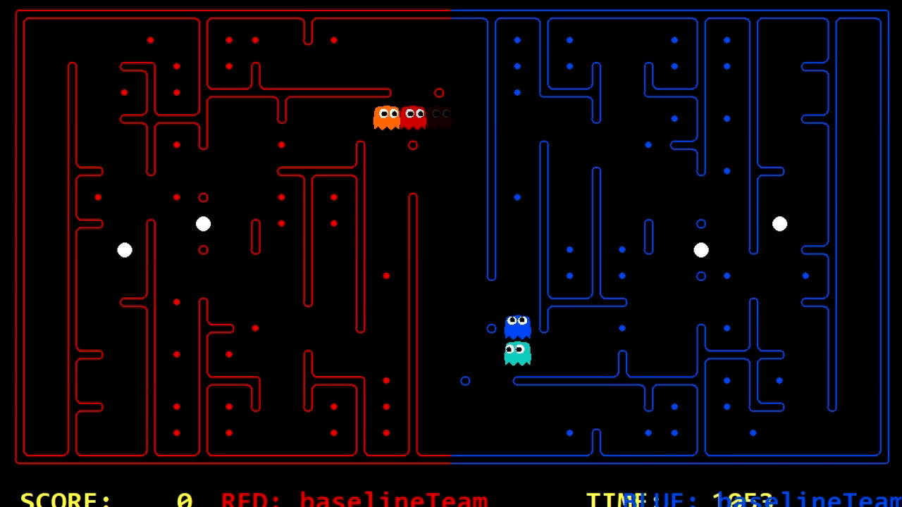
Approaches
Attacker Agent
A-star search and heuristic
Decision Tree
Avoid defenders
Avoid all enemies
When no enemy is detected, we find food and eat them.
When enemy is detected and near to attacker, we avoid enemy.
If there's not much time left, the attacker returns to the closest middle area with the carrying food.
For the capsule, we eat them when the attacker is close enough with it( < 5 steps). If the enemy is scared, we find the closet food and eat them as many as we can before the end of the scared timer.
(in this video, we are team blue)

Slide 5
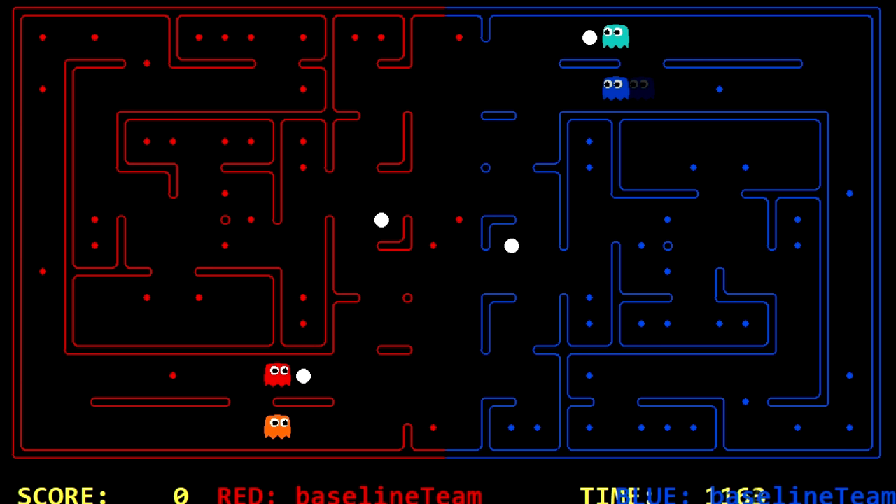
Approaches
Defender Agent
Q-Learning
At the beginning of each game, go the middle and detect invaders.
If there's one, chase it.
If none, stay, and detect the lost food.
If there is any foods near the middle, the defender will eat them.
If there's lost food, detect the enemy while on its way to the lost food.
update the defending food list and chase enemy if detected.
if invader is arrested, go back to the initial position(middle).
(in this video, we are team red)

Slide 6
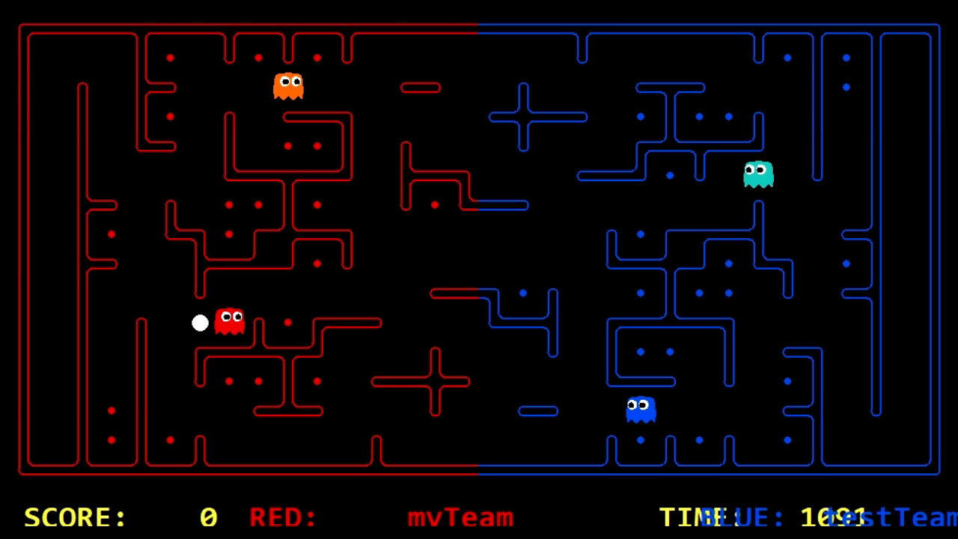
Approaches
Defender Agent
Q-Learning
At the beginning of each game, go the middle and detect invaders.
If there's one, chase it.
If none, stay, and detect the lost food.
If there is any foods near the middle, the defender will eat them.
If there's lost food, detect the enemy while on its way to the lost food.
update the defending food list and chase enemy if detected.
if invader is arrested, go back to the initial position(middle).
(in this video, we are team red)

Slide 7
Challenges Experienced
Attacker Agent
the balance between missing food not get caught
going into circles while being chased
getting stuck because the close food keep swinging between 2 food
The definition of the closest food
the true food distance
a weight divided by the distance of an enemy

Slide 8
Challenges Experienced
SOLVED
Attacker Agent
the balance between missing food not get caught
going into circles while being chased
getting stuck because the close food keep swinging between 2 food
The definition of the closest food
UNSOLVED
the true food distance
a weight divided by the distance of an enemy

Slide 9
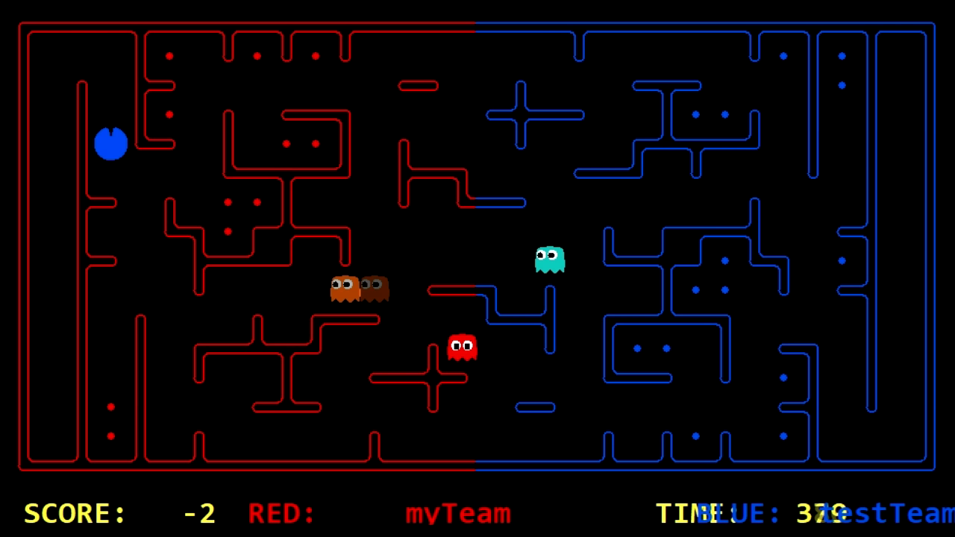
Challenges Experienced
Unresolved Problems for Attacker Agent
going into circles while being chased
getting stuck because the close food keep swinging between 2 food
(in this video, we are team red)

Slide 10
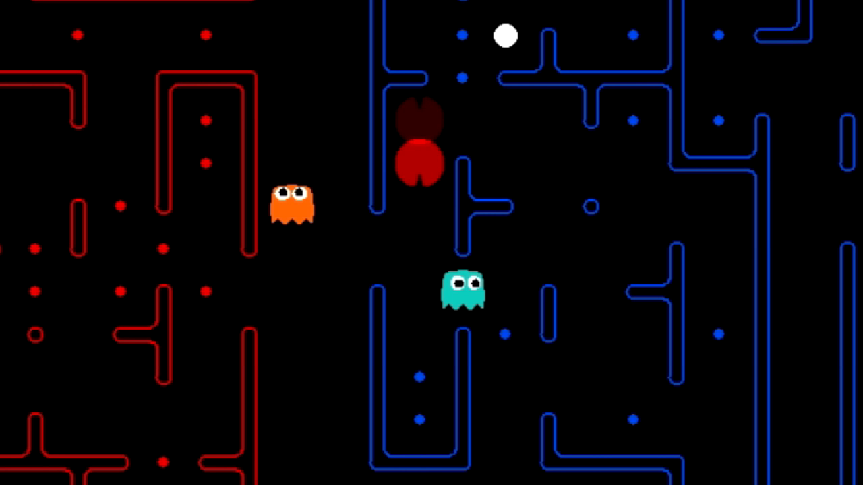
Challenges Experienced
Unresolved Problems for Attacker Agent
going into circles while being chased
getting stuck because the close food keep swinging between 2 food
(in this video, we are team red)

Slide 11
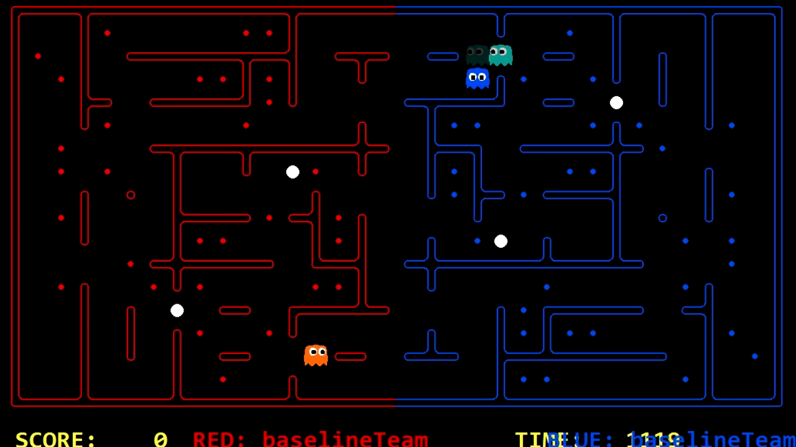
Challenges Experienced
Unresolved Problems for Defender Agent
defender is slower than the invader
defend two invaders at the same time
(in this video, we are team red)

Slide 12
Possible improvements
Attacker Agent
Defender Agent
The optimal way of doing this is whenever it is stuck, it would be able to detect this situation and pick another food as target thus attack on an other way
One idea to achieve this is by coughing them on their way back to their region. In another word, caught them in the middle or on their way home.

Slide 13
THX

